Slide 1


Process Engineering Group
Process Engineering Group (R&D - GIL)

Slide 2
Organizational Processes’ Needs
Objective :
PEG develop, maintain and institutionalize Organization’s and projects’ processes and metrics.
Scope :
This process is applicable to all activities under the purview of the R&D Division in Genus Innovation Ltd.
Vision :
Development, maintenance and assimilation of processes to aid and support the organization’s operations.
Institutionalization of the aforesaid processes.
Facilitation in adherence to the processes.
To develop and maintain a quantitative insight into the organization’s performance.
Roles and Responsibilities :
PEG was formed at Organizational level, Roles and Responsibilities also identified. Project Team Section of PEG Plan in EinFram.
.
Notes:
OPF SP 1.1 :
PEG formation to identify and improve process needs.
OPF SP 1.2
Sponsorship of the process appraisal from SM.

Slide 3
Organization Processes’ Needs
Goals of Current Year
Strengthen the Project Management Processes
Example : EinFrame as tool implemented for Project Management activities..
Organization’s Metrics review & revise :
Business objectives revised according to Business priorities and Vison, MBRs made, reviewed the current measurement goals, Line Rejection Percentage goal revised.
Business objectives to Process objectives mapped on basis of these measurement:
Line Rejection Percentage (Quality)
Schedule Variance (Delivery)
BOTOPO
Notes:
Line rejection percentage is the ratio of total line failures in a month and the total quantity produced in the month.
Schedule variance = (Actual Duration – Planned Duration)/Planned Duration
Efforts Variance = (Actual efforts-Planned efforts)/Planned efforts

Slide 4
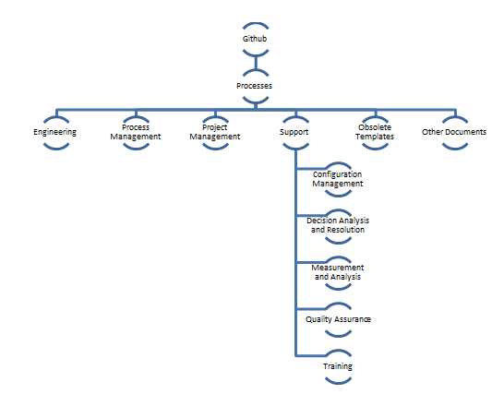
Process
PEG Annual Plan was prepared for working of PEG, consists of
Budget Plan (IR and Benchmark Appraisal from KPMG, Stationery)
Resource Plan (SVN, EinFrame, MS Office etc.)
Roles & Responsibility Plan
Training Plan
Configuration Management Plan (This repository contains all artifacts of PEG working activities.)
Quality Plan (Consists of Audit, Senior Management Review)
Measurement & Analysis Plans
Monitor and Control
Action & Release Plan (Project Tasks).
Structure of QMS
PRCD_CONFIG (Page No. 10)
Notes:
Budget, Resources, Responsibilities, Training, Configuartion, Audit, SM Review, Action, Release

Slide 5
Quality Management System (QMS)
Policy : A policy is a deliberate system of principles to guide decisions and achieve rational outcomes. A policy is a statement of intent, and is implemented as a procedure or protocol.
For example:
Genus Development Policy (POLC_DEVPOL)
Procedure : A fixed, step by step sequence of activities or course of action (with definite start and end points) that should be followed in the same order to correctly perform a task.
For example:
Project Planning Procedure (PRCD_PRJPLN)
Templates / Tools : A template is a form or pattern used as a guide to making something.
For example:
Hardware Design Template (TMPL_HDWDSN)
Checklist : A list of items to be noted, checked, or remembered.
For example:
Plan review checklist (CHKL_PLNREV)
Guidelines : A principle put forward to set standards or determine a course of action.
For example:
Firmware Coding Standards guidelines (GDLN_FRWSTD)
Logs : Project wise various review and testing defects available in Incident Management Report of EinFrame.
For example :
Incident Management

Slide 6
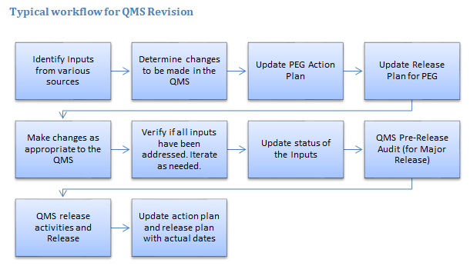
QMS Release and Deploy
QMS Release Audit : Pre-release audit is conducted with PQA Team member before Major release. Incident Management Report for Audit NCs
QMS Release Note : It includes all necessary information related to QMS Release.
QMS 4.1_QMSREL
QMS Release Mail : New version of QMS is released for use and team is intimated via QMS Release Email which includes QMS release note.
QMS released mails
QMS Training : QMS release training is conducted by PEG. Venue and timings are intimated to team by Email.
QMS 4.0_Training
Notes:
OPF SP 3.1, 3.2 :
Implemented improvements as revise QMS objectively audit.

Slide 7
Process Improvements
Identify Process Improvement Opportunities through the following inputs :
Process Improvement Proposals : Process Practitioners log their suggestions related to process improvement. For example : Incident Management Report for Process Improvement Proposal
Audit Report : Auditor sends the “Audit Report” to PEG for analysis and identification of candidate process improvement opportunities. For example : Audit Reports
Training Report : Training Report in EinFrame. For example : Training Reports and Feedbacks via Mail
Project Learning's : During the Project and after the project closure, Project Practitioners forward the learnings in Incident learnings of EinFrame. For example : Incident Learning
Project Repository : Project Risks, Plan etc.
For example : Projects Repository in EinFrame
Project Metric : Metrics Reports
Process Appraisal : IR done by KPMG in August 2022. For example : Process Appraisal
Tailoring Proposals : From practitioners. For example : Tailoring Proposals
Notes:
OPF SP 1.2 :
Appraise the process as Gap Analysis.
OPF SP 3.2 :
Monitor the implementation by review.

Slide 8
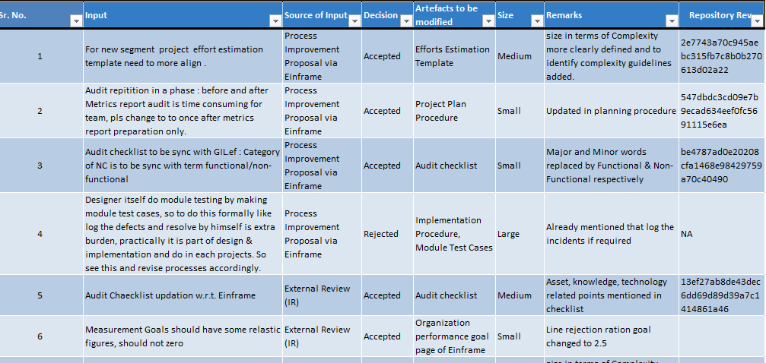
Process Improvements Implementation
All improvement opportunities / inputs captured in single sheet called PEG_QMSREQ
Notes:
OPF SP 3.2 :
Monitor the implementation PEG meeting.

Slide 9
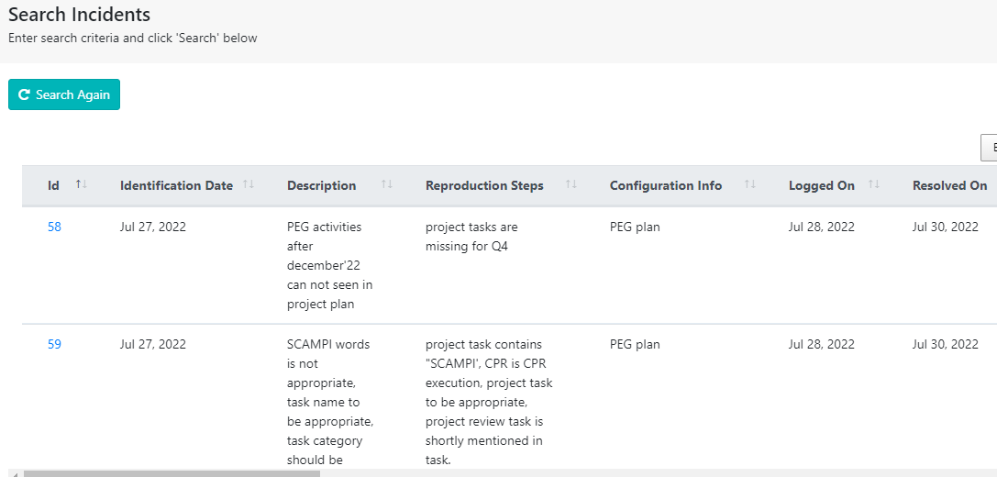
Monitoring and Control
PEG Periodic Team Meetings : Only Single person is in PEG.
Senior Management Review Plan : It includes plan of PEG activities review with Senior Management . During MBR release and Annual Plan release. PEG Senior Management Review Checklist and PEG Senior Management Review and Discussion MOM
Audit Plan : It includes audit plan of PEG activities. During major release of QMS and PEG audit in every 3 months. PEG Annual Plan
Incident Logged during PEG Audit :
.

Slide 10
Managing Performance & Measurement
To measure, identify and address performance issue:
In project plan ensure measurement and goals, tracked in project metric report. Organization metric monitored for all projects. PEG Annual Plan and Project GGE302 Plan
Map org business objective to process objectives.
Keep updated, define ,measure, analyze performance. BOTOPO
Store measured data and analyze in project level and org level both. MBR & Data
Follow set processes and keep updated. Project GGE302 Plan and PRCD_MEASUR
Ensure data quality
For Example : 1. Einframe Project report used as source to collect and verify the schedule variance data. These data verified during each milestone audits by PQA. Einframe_Project_Report
2. Google sheet maintained by production & quality for production quantities and line rejection quantites, used as tool to collect the data and the QA head verify the data.
Production quantity can also be verified by SAP "MB51" transaction. Production_Rejection_Google_sheet
Use org measurement repository
Project actual efforts used during next similar project’s efforts estimation activity. Einframe_Project_Report
Analyze org performance and identify improvement needs. MBR
Periodic sharing of performance measurement data to organization. MBR

Slide 11
Tailoring
One standard process often cannot be fit all of an organization’s projects, the solution to this problem is usually to allow for tailoring of the standard process to accommodate the attributes and characteristics of individual projects.
Example:
Tailoring Proposals received from GGE295 DC-DC Converter Project
Matrix Report combined for RD & Planning Phase due to project time is one month and matrix report making in first phase is not possible due to unavailability of EVMS data in 3-4 day in EinFrame.
Tailoring Proposals received from GGS151 3KVA MPPT PCU Project
Audit merge of RD phase and Planning Phase.
Implementation part of (Design and implementation phase) need to merge with Integration Phase
Tailoring requests approved keeping in mind of Project workflow and duration (size) of project.
Tailoring guideline
Notes:
Lifecycle model decided and mentioned in tailoring guideline : Waterfall (OPD SP1.2)
Tailoring guidelines to create project defined process. (OPD SP 1.3)

Slide 12
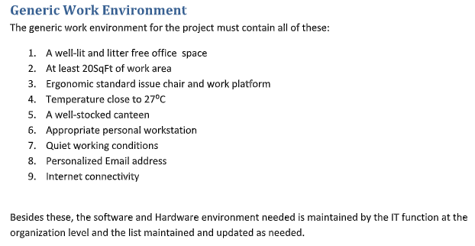
Guidelines
Generic Work Environment
Generic work environment includes basic requirements for Projects’ execution at Organization level.
Notes:
OPD SP 1.6 :
Generic work environment define, by analyzing existing and add new to fill gaps.

